Slide 1

Welcome to YR3 C25 QUB Practice Managers Update
Charise Boal
General Practice Recruitment Officer
E: Charise.boal@qub.ac.uk
M: 07741 898 425
Dr. Louise Sands
YR3 Clinical Lead
M: Louise.Sands@qub.ac.uk
gpadmin@qub.ac.uk
e.burns@qub.ac.uk
W:https://www.qub.ac.uk/sites/qubgp/
Notes:
Welcome, intro to all at meeting, format FAQ opportunity at end

Slide 2
Year 3 GP placements C25
Not part of C19: Completely new as part of C25 in academic year 2022-23
From 4 x 6 - week placements to 12 weeks continuously
Wednesday morning sessions
Option to take 2 x 12 weeks (over two semesters)
Immersion and preparation for YR4 GP Placements

Slide 3
General Practice across the QUB Medical School Curriculum 2024/2025
Year 1
Year 2
Year 3
Year 4
Year 5
FAMILY MEDICINE
Family Attachment
5 PM sessions inc. home visits
FAMILY MEDICINE
General Practice Experience
5 PM sessions
GENERAL PRACTICE
LONGITUDINAL CLERKSHIP
4 x 2 weeks
Preparation for Practice (primary and preventative care)
7 weeks
GENERAL PRACTICE
ATTACHMENT
12 Wednesday AM sessions

Slide 4
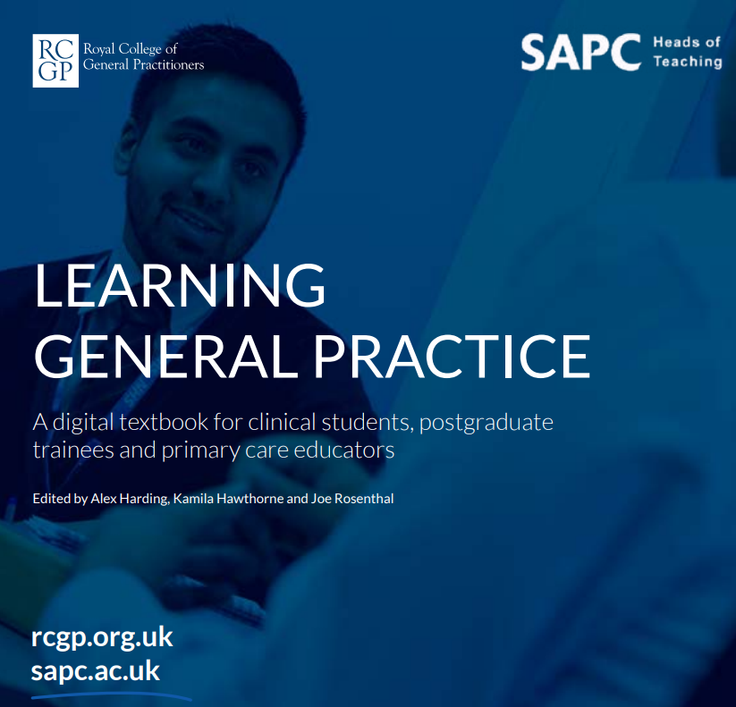
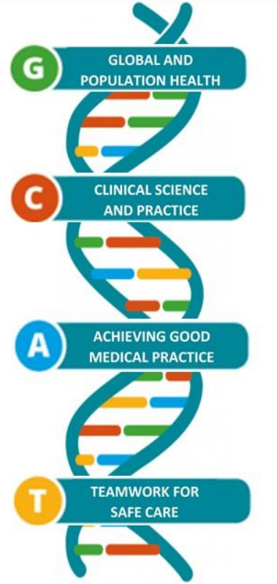
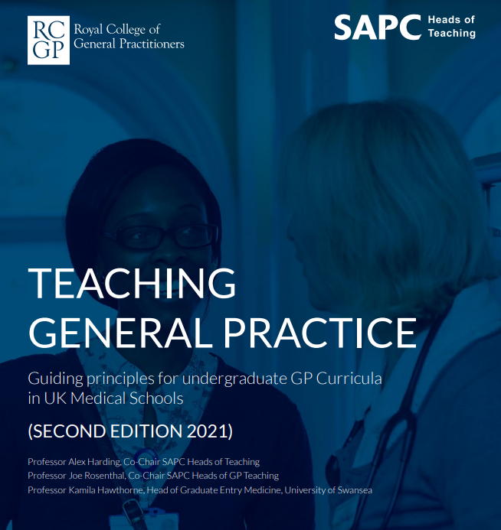
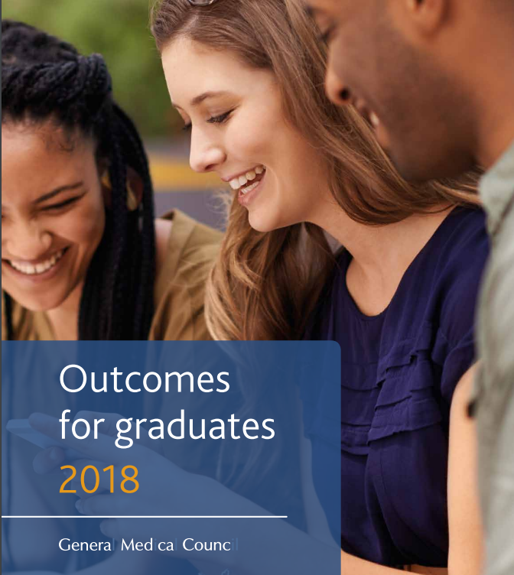
Each year the GP attachment has a different ‘focus’ based on the SAPC/RCGP guidance ‘Learning General practice’

Slide 5
Year 1 and 2 Family Medicine:
Tuesday and/or Thursday afternoons, paid at £41.67 per student. Groups of 8-10 students.
YR1- Pairs of students are matched to patient/families + five afternoon tutorials.
YR2 -five afternoon tutorials through the year where students can learn about the world of General Practice through contact with patients and members of the Primary Care Team.
Year 4:
A pair of students for 8 weeks across the academic year. Practices can host up to 4 pairs of students.
Flexible integration into work of the whole practice team. Pillar structure (reproductive health, child health, mental health, and Ageing and Health )
£8800 per pair of students per 8 weeks.
Year 5:
A pair of students for 7 week placement with the option to take 3 pairs for 3 placements
YR5 students will have had 8 weeks of GP experience in YR4 and have sat their written MLA exam,
They want to be independently consulting and leading on consultations (under supervision)
£7700 per pair of students per 7 weeks

Slide 6

Year 3 C25
The aim is to build on the YR2 Family Medicine experience through a range of suggested activities to allow students to gain a greater understanding of GP work and patients with all their complexity
- Talking to patients
- Reviewing Patient notes
- Virtual Primary Care (VPC)
- Shadow Nurses/ Practice Nurse/ Treatment room

Slide 7
Dates and scheduling
The same group of 6 students allocated to your Practice for 12 weeks
Provisional Dates for Placement
SEMESTER 1
11th September- 4th December 2024
SEMESTER 2
5th February – 21st May 2025

Slide 8
Year 3 Student GP experience
12 Wednesday mornings in your practice
Intro session week 1
via ZOOM- QUB
Review session week 14
via ZOOM - QUB
6 students per group
Students working in pairs or greater

Slide 9
Main Learning activities – patient contact
Home Visit
Telephone call
Face to Face

Slide 10
Main Learning activities – Practice Team
Main Learning activities – practice team contact
Nursing
Pharmacist
MDT
Practice Manager

Slide 11
Year 3 C25 Sample
Student
GP Timetable
Week |  | Student 1 | Student 2 | Student 3 | Student 4 | Student 5 | Student 6
1 | 9-9:30 | Intro to practice for group
 | 9:30-12 | Hot seat | Hot seat | Case based discussion | Case based discussion | Practice team | Practice team
 | optional | Practical skills/ VPC
 | 12-1 | Case presentation by students and discussion; VPC discussion
2 | 9-12 | Case based discussion | Case based discussion | Practice team | Practice team | Hot seat | Hot seat
 | optional | Practical skills/ VPC
 | 12-1 | Case presentation by students and discussion; VPC discussion
3 | 9-12 | Practice Team | Practice Team | Hot seat | Hot seat | Case based discussion | Case based discussion
 | optional | Practical skills/ VPC
 | 12-1 | Case presentation by students and discussion; VPC discussion
4 | 9-12 | Hot seat | Hot seat | Case based discussion | Case based discussion | Practice team | Practice team
 | optional | Practical skills/ VPC
 | 12-1 | Case presentation by students and discussion; VPC discussion
5 | 9-12 | Case based discussion | Case based discussion | Practice team | Practice team | Hot seat | Hot seat
 | optional | Practical skills/ VPC
 | 12-1 | Case presentation by students and discussion; VPC discussion
6 | 9-12 | Practice Team | Practice Team | Hot seat | Hot seat | Case based discussion | Case based discussion
 | optional | Practical skills/ VPC
 | 12-1 | Case presentation by students and discussion; VPC discussion
Notes:
SDL- self directed learning
HHF- Healthcare Human Factors

Slide 12
Other learning activities
Self –directed - Virtual Primary Care (VPC)
Peer learning with year4/5 students
Patient notes review

Slide 13

What is expected from the practice/tutor
It is the student’s responsibility to ensure that all required elements of MyProgress are completed.
The GP must complete a GP Tutor Feedback at the end of the placement.

Slide 14
What must each student complete?
must each student complete?
What must each student complete?
What must each student complete?
Clinical Consultations – 2 needed
Case-based Discussion (CBD) - 1 needed
Entrustable Professional Activity (EPA) – student self-rates at start and at some later point in placement
Student Reflection on GP Tutor Feedback (student completes after GP sign off)

Slide 15

What do the students say?
A lot of patients present with non-specific symptoms so for a GP to be able to quickly hone onto a couple of possible diagnoses is a brilliant skill.
How enthusiastic and welcoming the staff were
Getting an inside look into the running of a GP surgery and getting a feel for how GPs operate in their day to day was very interesting

Slide 16
What did GP Tutors think?
Students well prepared, enthusiastic and engaged very well.
Students enjoyed taking unfiltered histories and presenting them.
Students have been motivated and have enjoyed practice time.
Students had improved awareness of role of GP and introduction to members of MDT.

Slide 17
The best bit about teaching Year 3’s has been.....
Witnessing their energy and enthusiasm and willingness to learn about GP- they don’t tend to have preconceived ideas so it is really lovely to teach them at this stage in their studies.

Slide 18
What happens in real life?

Slide 19


(Based on SUMDE tariff up to 31/3/23)
  Each group of 6 students attached 12 week placement
  £250 per session
  Approximate renumeration based on current SUMDE rates and anticipated placements
  6 students x 12 Wednesday AM Placements = £3000
  (12 students across 2 terms = £6000)

Slide 20

What we need from you
Complete the availability tool
  Review the options Monday 8th January 2024
  Your practice availability opens Monday 19th February 2024
Can you host students for 1 or 2 semesters?
We can talk and meet over the next few months
We need you!

Slide 21



Your Questions
Visit the QUBGP website for info
https://www.qub.ac.uk/sites/qubgp/
See me, I can visit your Practice
My contacts:
07741 898 425
Charise.boal@qub.ac.uk

